Slide 1
Functions and Prototyping

Slide 2
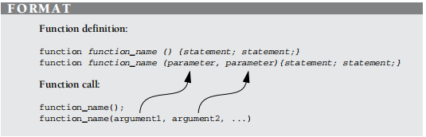
Function Declaration and Invocation

Slide 3
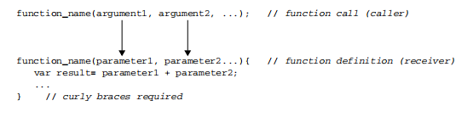
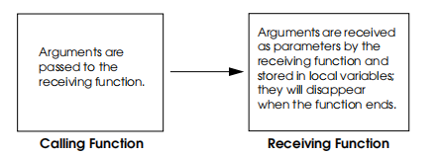
Passing Arguments to a Function

Slide 4
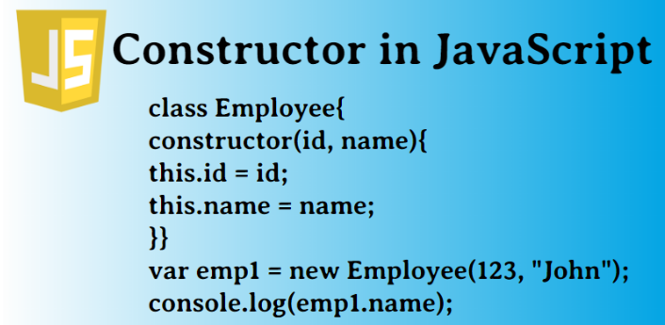

Slide 5
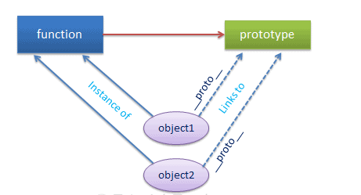
JavaScript Prototype

Slide 6
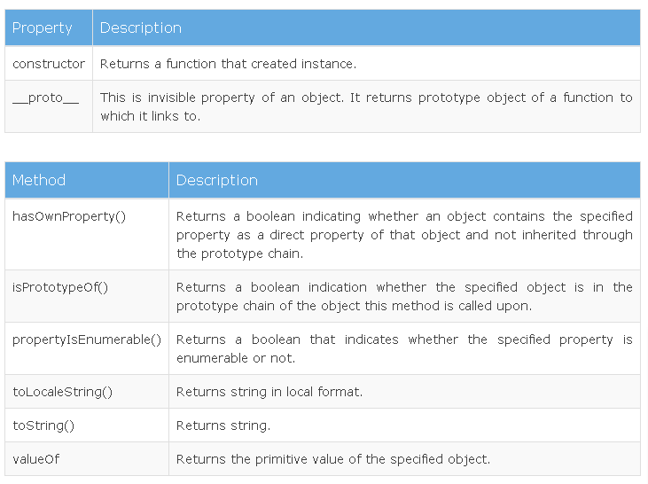
Prototype Properties and Methods

Slide 7
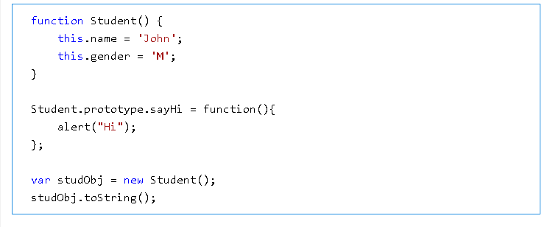
Use of Prototype

Slide 8
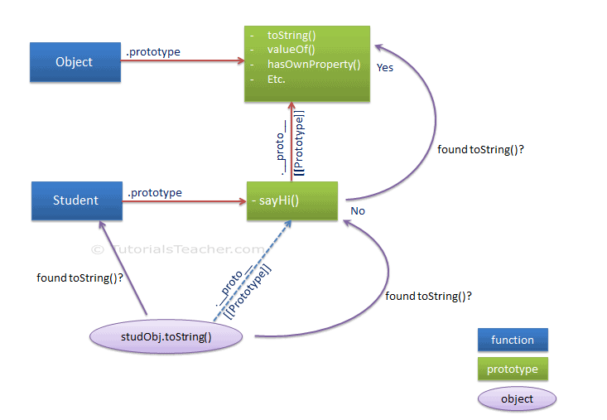
Use of Prototype

Slide 9
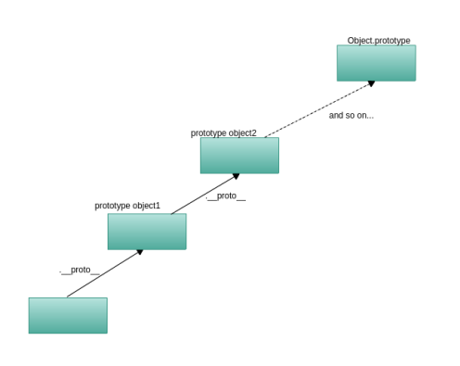
Prototype Chain

Slide 10
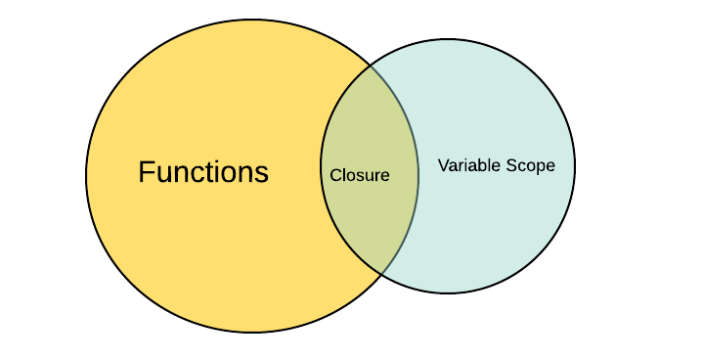
Closures in JavaScript

Slide 11
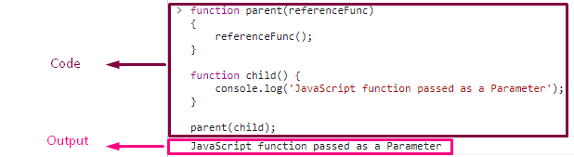
JavaScript Function as Parameter

